Slide 1
Introduction to Programming in Python
Ezekiel Adebayo Ogundepo (@gbganalyst)

Slide 2
Comment in Python

Slide 3
Comment in Python
Adding comments to your code is a common practice in all programming languages.
This is important because:
It makes you remember a line of code you have written after leaving it for a while
It makes other who want to check your code to understand it line by line
It is good for documentation purpose
In order to add comments to your codes, you will use the # sign before writing your comments.

Slide 4
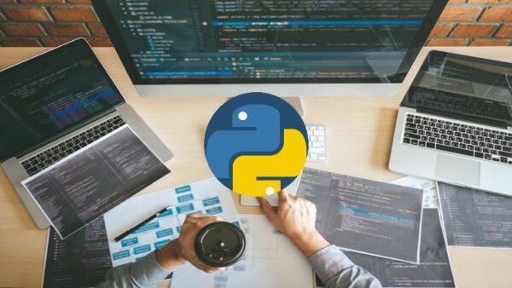
Lab session

